Slide 1
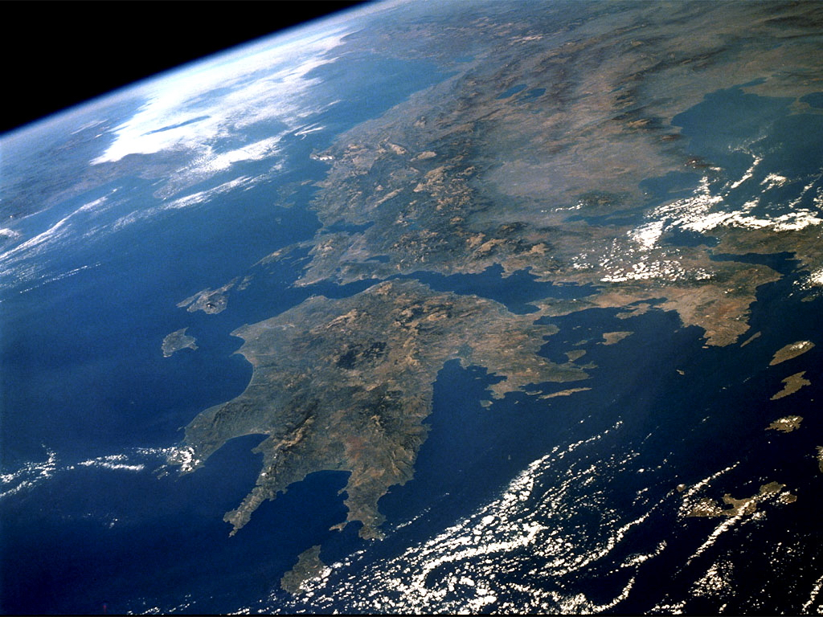
Environmental Profile of Greece

Slide 2
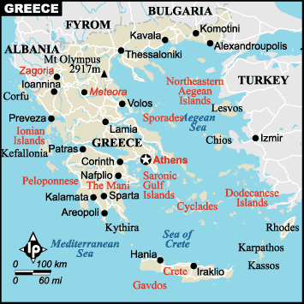
Basic Information
Hellas is a small sea state only 131,990 km² (96th in international category as it concerns the total area) of the Mediterranean Sea.
Greece has land borders with Albania, former Yugoslavia Republic of Macedonia, and Bulgaria to the north, with Cyprus and Turkey in the east, with Italy to the west and with Egypt and Libya to the south.
Has the 11 longest coastline in the world (13,676 km) with a significant huge number of island (more than 1,400)
Only 8% of it land consists of mountainous, of which Mount Olympus is the highest (2,917 meters)

Slide 3
Biodiversity Paradise …
According to European Environmental Agency Greece is in a biodiversity ’hot spot’ region, with more than 1 500 endemic species and more than 70 % habitat loss in historic times (EEA, 2007), hosting a notable biodiversity, while its flora and diversity in certain animal groups (e.g. birds, reptiles, terrestrial mollusks, isopods) is amongst the highest in Europe and the Mediterranean

Slide 4
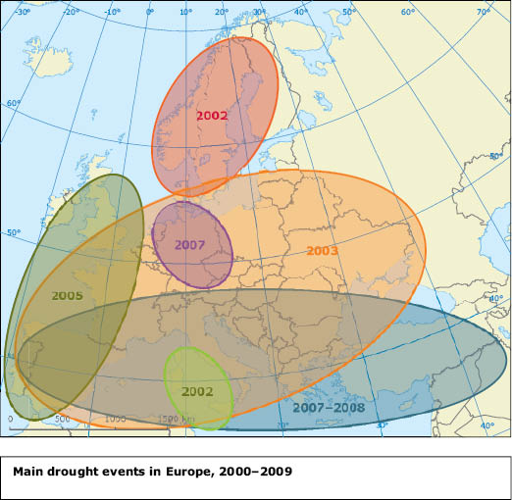
… but highly threatened.
Nature protection needs in Greece arise from urban sprawl, infrastructure development, over-exploitation of species and natural resources, pollution, eutrophication, desertification, intensive agriculture in the lowlands and land abandonment in more remote regions, often of high nature value. In coastal areas, the uncontrolled expansion of tourism and/or illegal fishing activities, the invasion of aquatic alien species due to rising sea temperature constitute additional factors threatening our ecosystem biological functions and processes.

Slide 5
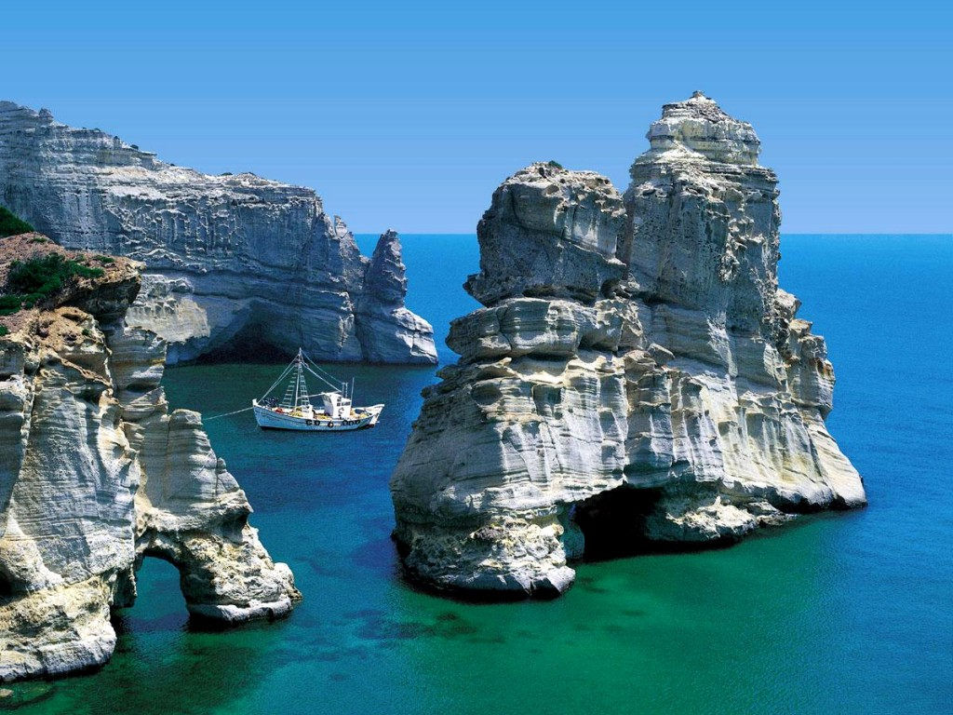
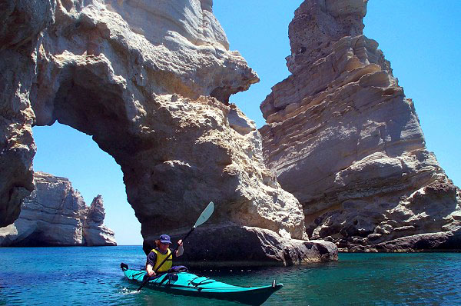
The Island of Milos
There are about 30 sea arches around the Greek Island of Milos. Probably the most beautiful area is Kleftico in the southwest part of the island, containing numerous arches and sea tunnels accessible only by boat.

